Slide 1
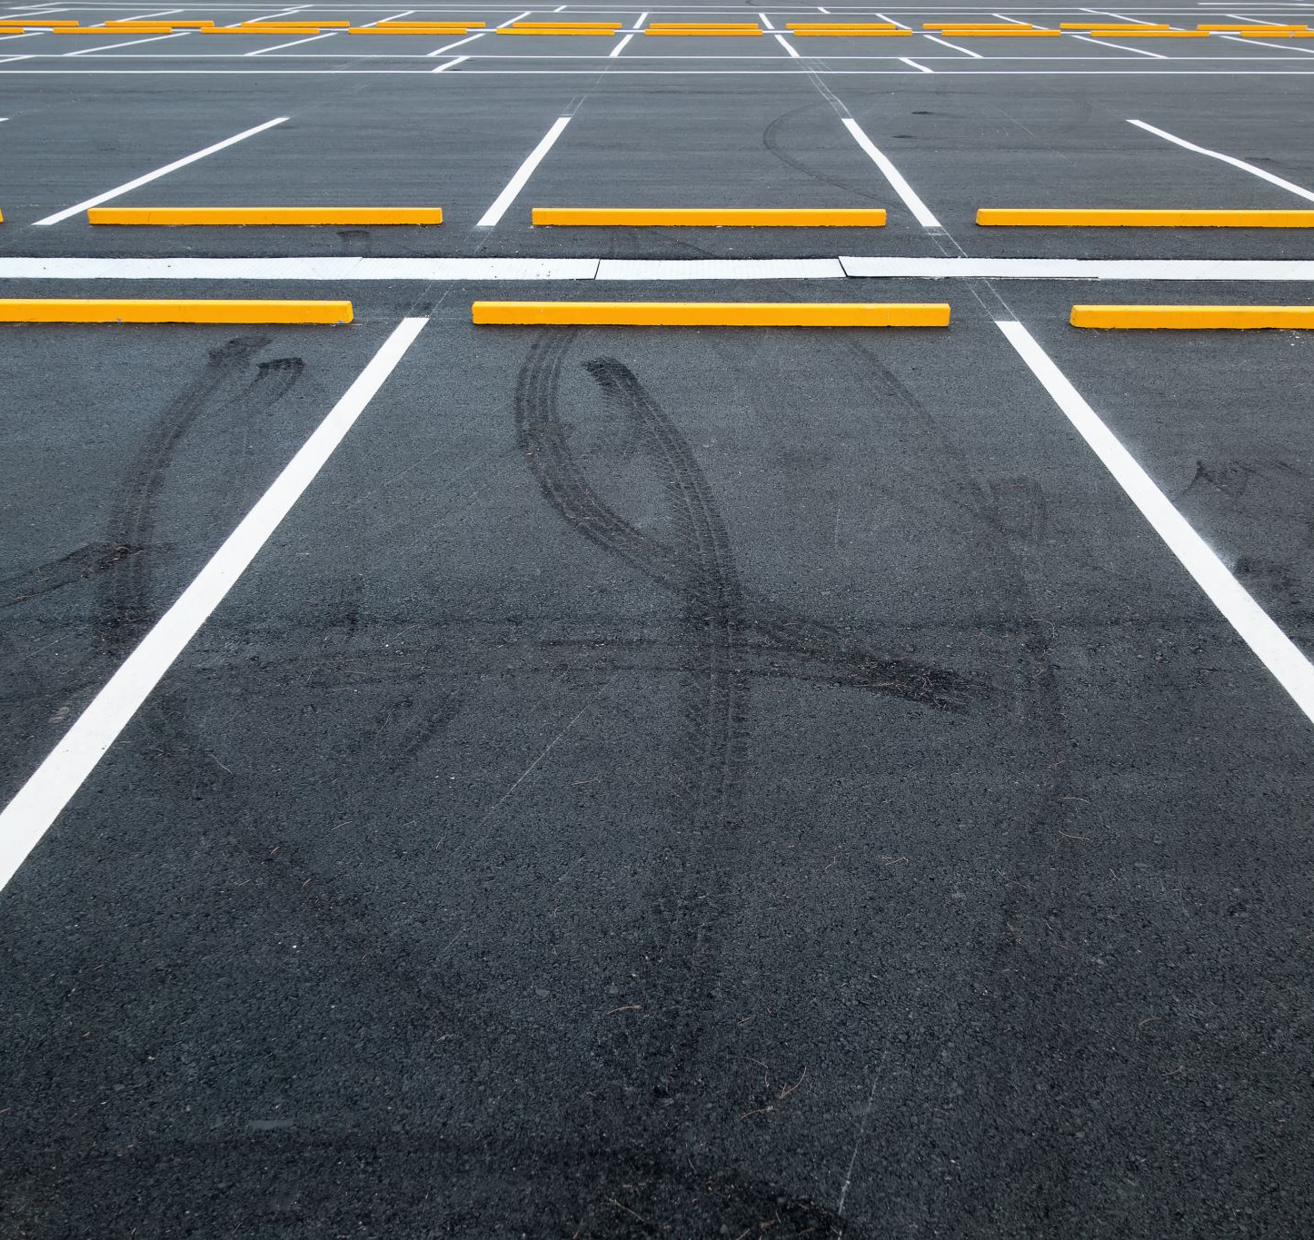
Parking Utilization Analysis
City of Irvine – Summative Assessment
Presented by: Allen Day
Notes:
Welcome, and thank you for reviewing my Parking Utilization Analysis.
This assessment looks at real occupancy data from two parking lots in the City of Irvine over a four-week period, from November 20th through December 17th. The goal of this study is to understand how consistently each lot operates near or at capacity, identify the time windows with the highest stress on parking supply, and highlight any operational or planning needs.
My name is Allen Day, and in this presentation I’ll walk through the dataset, the utilization patterns we observed, and the recommendations based on the data.

Slide 2
Implementation Roadmap
Short-term: Dynamic pricing and real-time monitoring.
Mid-term: Remote parking with shuttle service.
Long-term: Lot expansion and infrastructure upgrades.
Notes:
On this slide, I’m outlining a phased implementation approach that helps us address both the immediate congestion problems and the long-term parking challenges we’re facing.
In the short term, our quickest wins will come from introducing dynamic pricing and expanding real-time monitoring. Dynamic pricing—used in cities like San Francisco through their SFPark program—helps shift demand naturally by offering lower prices during off-peak periods and slightly higher rates during the busiest hours. Pairing that with live occupancy data allows drivers to see available spaces before entering a lot, which reduces circling and cuts down on unnecessary traffic.
In the mid-term, we can move toward establishing remote parking options supported by shuttle services. This is especially useful during special events or seasonal peaks. Irvine already uses similar strategies for large-scale events at the Great Park, so expanding that model to the civic center and high-demand commercial zones is a practical next step. This allows us to divert overflow before lots reach saturation.
In the long term, the data clearly supports evaluating physical expansion and broader infrastructure upgrades. Both lots consistently exceed 90–100% occupancy during peak periods, which is well above the recommended operational threshold for smooth traffic flow. Whether that means adding structured parking, redesigning existing lots, or exploring shared-use partnerships, we’ll need to plan ahead as our population and business activity continue to grow.
Overall, this roadmap balances immediate relief with sustainable long-term capacity planning, ensuring Irvine stays ahead of demand rather than falling behind it

Slide 3
Challenges & Constraints
Lot02 frequently hits 100% occupancy, causing turn-aways.
Lot01 remains above 90% for long periods, creating congestion.
Drivers experience frustration and longer search times.
Structural under-supply during peak hours.
Notes:
On this slide, I’m highlighting the main operational challenges we identified across both parking lots.
First, Lot02 frequently reaches 100% occupancy, which means drivers are routinely turned away. This creates unnecessary circulation and adds pressure to nearby lots.
Second, Lot01 consistently stays above 90% occupancy for long stretches, and once a lot hits that threshold, it effectively feels full from a driver’s perspective. This leads to congestion, circling, and slower movement within the facility.
These high occupancy levels translate directly into frustration for users. Drivers spend more time searching for a space, which increases traffic within the lots and surrounding streets.
Overall, the pattern points to a structural under-supply during peak hours, meaning demand is exceeding available capacity, not just occasionally but as a recurring daily trend. This is an important factor as we consider solutions like smart-parking technology or demand-shifting strategies

Slide 4
Future Vision for Parking Management
Deploy smart parking systems with IoT sensors.
01
Implement dynamic pricing to manage demand.
02
Integrate real-time availability into mobile apps.
03
Promote sustainable transport options.
04
Notes:
“As we look ahead, our goal is to position Irvine as a leader in modern mobility and smart-city infrastructure. This vision builds on the trends we identified in the data—consistent peak congestion, high user frustration, and structural under-supply in our busiest lots. To address this proactively, we’re outlining a forward-thinking approach that focuses on technology, efficiency, and sustainability.”
“First, deploying smart parking systems with IoT sensors will give us real-time visibility into parking capacity across the city. Cities like Los Angeles, San Diego, and San Francisco have already implemented sensor-based systems that reduced circling time and improved traffic flow. Implementing this step allows us to monitor patterns dynamically instead of relying solely on manual logs.”
“Second, dynamic pricing can help manage demand more evenly throughout the day. This means adjusting prices during peak hours to reduce congestion and incentivizing drivers to park during lower-demand times. This method is already used successfully in several major cities and helps stretch existing capacity before building more lots.”
“Third, integrating this data into mobile apps will give residents, commuters, and visitors real-time availability before they even arrive at a lot. This reduces circling, cuts emissions, and improves user satisfaction. This strategy aligns with Irvine’s ongoing Smart City Framework, which prioritizes digital service delivery and efficient mobility solutions.”
“Lastly, promoting sustainable transportation—such as expanded bike networks, transit partnerships, and micro-mobility options—reduces pressure on our parking ecosystem entirely. As Irvine continues growing, especially around the Spectrum and Great Park districts, having these alternatives in place will be essential for long-term mobility resilience.”
“Altogether, these strategies move Irvine toward a balanced, technology-driven parking ecosystem that supports economic growth, improves the resident experience, and prepares the city for future demand.”

Slide 5
Dataset Overview
Lots analyzed: Lot01 (863 spaces) and Lot02 (387 spaces)
Time period: 11/20/22 – 12/17/22
Granularity: Readings every ~30 minutes from 8:00 to 16:30
Fields: LotCode, LotCapacity, LotOccupancy, TimeStamp, Day, OccupancyRate
Notes:
On this slide, I’m laying out the foundation of the dataset used for the analysis. We examined two parking lots: Lot01 with 863 total spaces and Lot02 with 387 spaces. The timeframe covers nearly a full month, from November 20th through December 17th.
Data was captured roughly every 30 minutes throughout the active day, from about 8:00 AM to 4:30 PM. That gives us consistent snapshots of real-time parking demand across both locations.
The dataset includes the key fields we need to understand utilization patterns: the lot identifier, the total capacity, the number of occupied spaces at each reading, the timestamp, the day of the week, and the calculated occupancy rate.
Altogether, this structure gives us a clear and reliable view of how both lots behave hour-to-hour and day-to-day, which becomes the foundation for the boxplots, scatterplots, and final recommendations later in the presentation.

Slide 6
Overall Utilization Trends
Notes:
On this slide, we’re looking at the combined utilization trends for both Lot01 and Lot02 across a typical day. What really stands out is how quickly demand ramps up in the morning.
Around 8:00 AM, occupancy is still manageable—roughly 30% for Lot01 and about 40% for Lot02. But by 9:30 AM, both lots experience a steep climb, with Lot02 already approaching heavy use as it nears 90% capacity.
By 11:30, we consistently see both lots hitting their operational peak. Lot02 is essentially maxed out at or near 100% utilization, and Lot01 is right behind it in the mid-90% range. At this level, drivers feel the lot is functionally full—they end up circling, slowing traffic, and creating localized congestion.
As we move into early afternoon, the utilization tapers slightly, but both lots remain heavily used through 16:30. This shows that the pressure on our parking system isn’t a short, isolated spike—it’s sustained for several hours each day.
Overall, these trends clearly indicate structural capacity challenges, especially in Lot02, and they support the case for implementing smarter, real-time parking management tools to reduce bottlenecks and improve driver experience

Slide 7
Lot01 Utilization
Notes:
On this slide, we’re looking specifically at Lot01, which has the largest capacity at 863 spaces. What immediately stands out is how quickly the lot fills once the morning hours begin.
At 8:00 AM, occupancy sits around 30%, which aligns with early office arrivals and morning visitors. By 10:00 AM, usage jumps to 80%. This rapid increase shows that Lot01 is heavily relied on as one of the primary parking resources in the area.
Mid-day, around 12:00 PM and 2:00 PM, we see occupancy levels hovering around the 90–95% range. This is essentially functionally full, because anything above 90% causes longer search times and internal congestion as drivers circle for a remaining space.
Even by 4:00 PM, the lot remains at about 80%, suggesting strong, consistent demand throughout the day—not just during the lunch rush. Overall, this pattern points to sustained pressure on Lot01 during normal business hours and reinforces the need for improved demand management and real-time visibility for drivers

Slide 8
Lot02 Utilization
Notes:
Now let’s take a closer look at Lot02, which has a smaller capacity of 387 spaces but consistently shows the highest level of demand.
At 8:00 AM, occupancy is already around 45%, which is noticeably higher than Lot01 at the same time. This suggests that Lot02 attracts early arrivals—likely because of location, convenience, or proximity to key facilities.
By 10:00 AM, Lot02 jumps to roughly 95% occupancy. This spike happens quickly and shows that peak demand forms early in the day. By noon, the lot reaches full capacity at 100% and essentially stays maxed out through the early afternoon.
At 2:00 PM, we still see occupancy holding near 98%, meaning there’s almost no turnover and very limited parking availability for new arrivals. Even at 4:00 PM, occupancy remains high at about 90%, which indicates that departures are slow and demand stays strong throughout the entire business day.
The takeaway here is that Lot02 operates at or near capacity for most of the day, creating regular turn-away situations and pushing overflow demand to surrounding lots. This behavior makes Lot02 a prime candidate for real-time occupancy monitoring, dynamic pricing, and targeted demand management strategies.

Slide 9
Weekday vs Weekend Utilization
Notes:
On this slide, I’m comparing how parking demand shifts between weekdays and weekends. What we see here is a consistent pattern across both lots: weekday utilization is noticeably higher during late morning and mid-day hours. This aligns with traditional commuter and business-hour activity within the City of Irvine, especially around job centers, retail corridors, and City Hall operations.
In the late morning window, occupancy on weekdays frequently approaches or exceeds the 90% threshold, which is typically considered the operational ‘full’ point in parking management because drivers start spending more time circling for spaces. Weekends, while still busy, show slightly lower peaks, indicating more varied arrival patterns and fewer simultaneous high-demand periods.
By mid-day, weekdays continue to run hotter than weekends, which reinforces the idea that the majority of parking pressure comes from work-related and scheduled daytime activity. In the afternoon, the gap narrows because weekday demand begins tapering as employees head out, whereas weekend activity smooths out more gradually.
Overall, this comparison helps us understand that while weekends do contribute to congestion—especially around entertainment, dining, and shopping zones—the highest stress on the parking system is happening during weekday business hours. This is a key indicator that any smart-parking solution must account for intense weekday peaks and provide mitigation strategies specifically for the mid-day congestion cycle

Slide 10
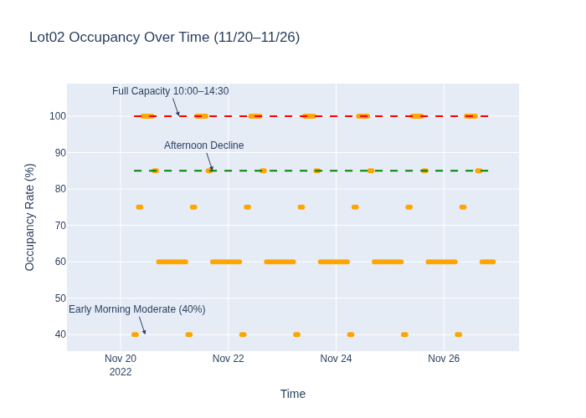
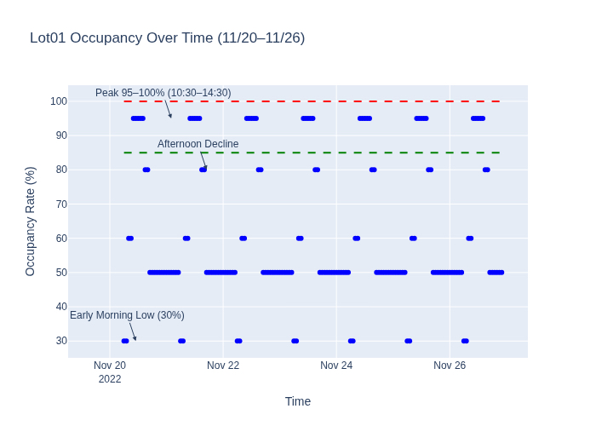
Scatter Plots: Lot01 vs Lot02
Notes:
On this slide, we’re looking at the detailed scatter plots for Lot01 and Lot02 during the week of November 20th through November 26th. These visualizations help us see not just averages, but the actual occupancy movement throughout each day.
Starting with Lot02 on the left:
We can see that this lot consistently reaches full capacity—100%—between roughly 10:00 AM and 2:30 PM. Those upper red markers show long stretches where no spaces were available, which indicates a high probability of driver turn-aways during these hours. We also see a clear early-morning moderate zone around 40%, showing that demand ramps up sharply mid-morning.
Looking at Lot01 on the right, we see a similar but slightly less intense pattern. Lot01 peaks in the 95–100% range between 10:30 AM and 2:30 PM, shown by the cluster of dark blue points near the top of the chart. This lot rarely hits a clean 100%, but it is extremely close for several hours, which still creates congestion and slower circulation for drivers.
Both scatter plots also show a consistent early-morning low point followed by a steep rise and then a gradual decline in the afternoon. The important takeaway is that both lots are experiencing synchronized peak demand, which creates system-wide strain rather than isolated congestion. These patterns strongly reinforce the need for smarter load distribution, demand management, and real-time availability tools.

Slide 11
Executive Summary
Peak congestion observed between 10:00–14:30 across both lots.
Lot02 consistently reaches 100% occupancy, indicating severe capacity constraints.
Lot01 also operates above 90% for extended periods, creating structural under-supply.
Strategic priorities: Implement demand management, remote parking, and long-term expansion planning.
Notes:
On this slide, I’m summarizing the key findings from the full parking utilization analysis.
Across both parking lots — Lot01 and Lot02 — we consistently observed the highest congestion between 10:00 AM and 2:30 PM. This is the window where demand exceeds the system’s flexibility, and both lots operate near or at capacity.
Lot02 in particular stands out as the most constrained facility. It reaches 100% occupancy on a regular basis, often staying full for long stretches with almost no turnover. That level of saturation indicates not just high demand, but a lack of buffer capacity to absorb peak-hour surges.
Lot01, despite being the larger lot, also operates above 90% occupancy for long periods. From a transportation-planning perspective, anything above 85–90% creates the same driver experience as ‘full’—longer search times, congestion inside the lot, and increased circulation around the area.
Because both lots show structural under-supply during the middle of the day, our strategic priorities focus on three areas:
Demand management — tools like dynamic pricing and real-time information.
Remote parking options — supported by shuttle service to relieve central congestion.
Long-term expansion planning — including lot expansion and upgrades tied to expected city growth.
These insights help inform the recommended path forward for Irvine as we anticipate continued population and traffic growth

Slide 12
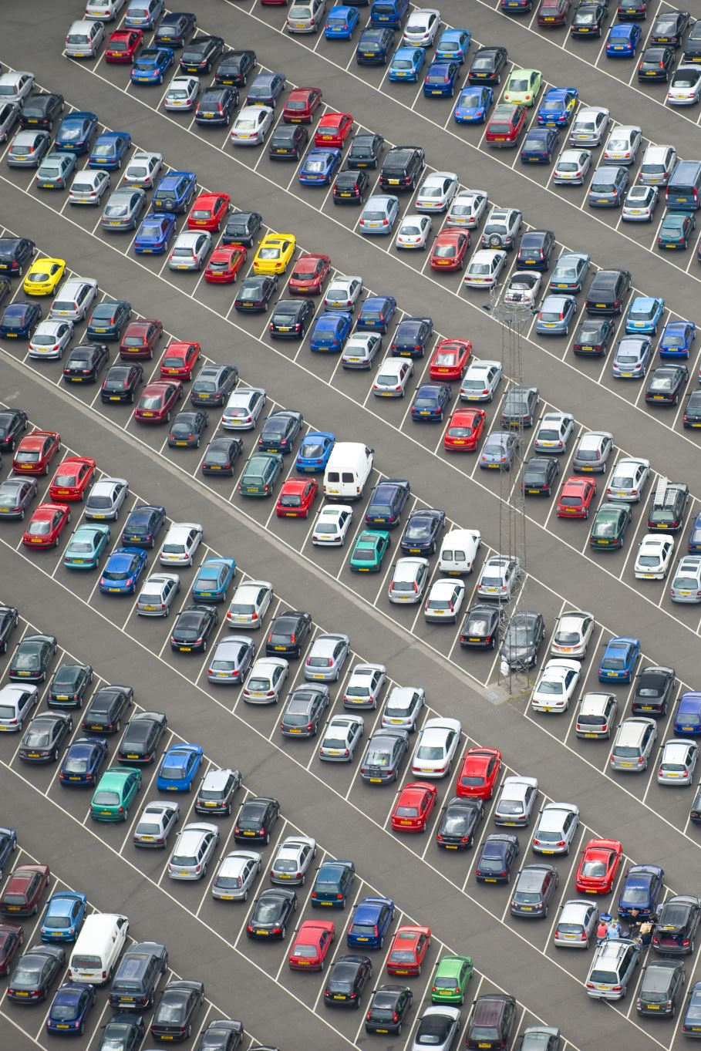
References
City of Irvine Parking Data (2022). Parking Utilization Records.
Shoup, D. (2011). The High Cost of Free Parking. APA Publishing.
Smart Cities Council (2023). Parking Management Strategies for Urban Areas.
Federal Highway Administration (2021). Demand-Based Parking Pricing Guidelines.
Notes:
Provide sources to validate analysis and recommendations.

